Slide 1
Food Recognition And Calories Estimation
SlideMake.com

Slide 2
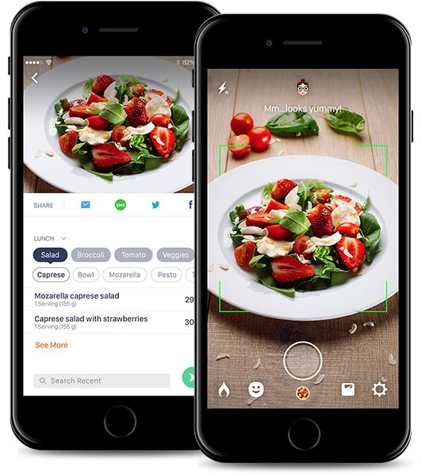
Introduction
Food recognition and calories estimation technology uses artificial intelligence to analyze images of food and provide accurate nutritional information.
This technology can help individuals make healthier food choices and track their calorie intake more effectively.
Companies and researchers are constantly working to improve the accuracy and accessibility of these tools.
Notes:
Image source: https://caloriemama.ai/

Slide 3
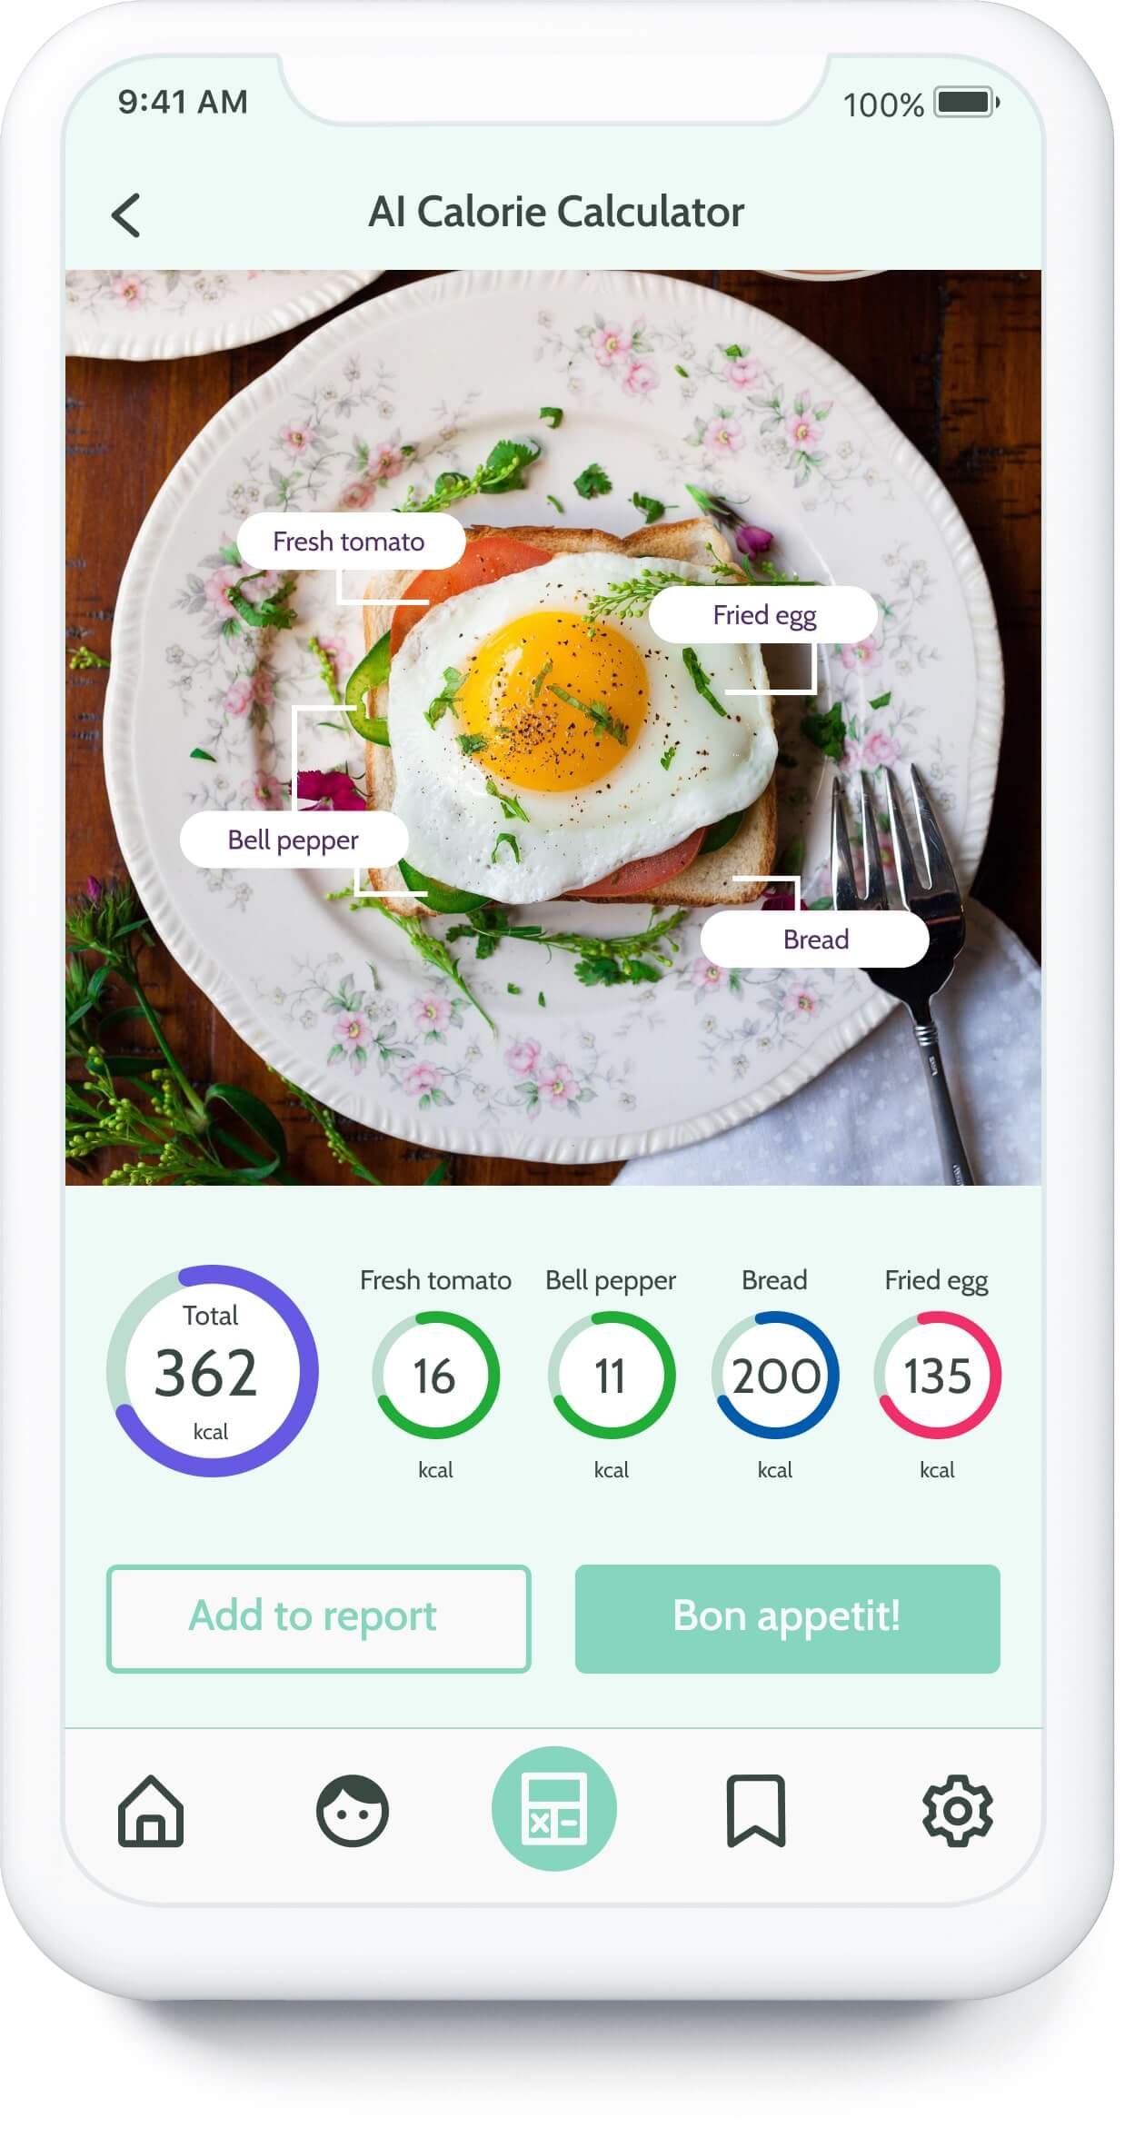
How Food Recognition Works
Food recognition technology uses deep learning algorithms to identify different types of food items in images.
These algorithms analyze various features such as shape, color, and texture to accurately classify the food.
Once the food is recognized, the system can estimate the number of calories based on the portion size and ingredients.
Notes:
Image source: https://azati.ai/portfolio/ai-calorie-calculator-and-food-recognition/

Slide 4
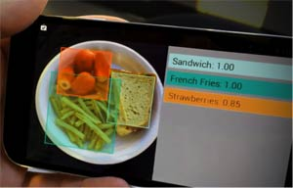
Implementation
Food recognition technology can help individuals with dietary restrictions or specific health goals make informed choices.
Firstly it will starts with uploading the image then the image will recognized by the ML, Deep Learning technology and the calerys and nutritional values are estimated by the help of Ai .
By using Computer vision technology we can scan the image also.
Notes:
Image source: https://www.sri.com/press/blog-archive/new-food-recognition-technology-lets-devices-see-whats-on-your-plate-to-help-you-decide-whether-to-eat-it/

Slide 5

Challenges
One of the main challenges of food recognition technology is accurately estimating portion sizes, as this can greatly affect the calorie count.
Different lighting conditions, angles, and presentation styles can also impact the accuracy of food recognition algorithms.
The need for a diverse and extensive database of food images for training the algorithms is crucial to improve accuracy.
Notes:
Image source: https://www.mynetdiary.com/estimating-portions-for-food-diary.html

Slide 6
Applications in Health and Fitness
Food recognition and calories estimation technology can be integrated into health and fitness apps to provide real-time nutritional information.
It can help users set personalized nutrition goals and track their progress over time.
Health professionals can also use this technology to monitor and support their clients' dietary habits more effectively.
Notes:
Image source: https://azati.ai/portfolio/ai-calorie-calculator-and-food-recognition/

Slide 7
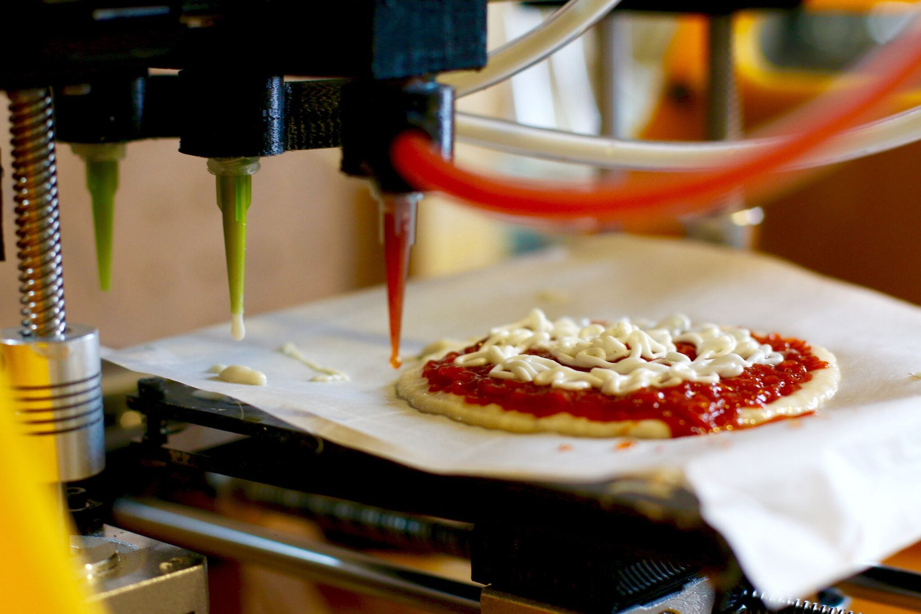
Future Developments
Researchers are exploring the use of 3D food scanning technology to improve portion size estimation and enhance the accuracy of calorie counting.
Advancements in artificial intelligence and machine learning algorithms are expected to further enhance the precision and speed of food recognition systems.
Integrating food recognition technology with wearable devices and smart kitchen appliances could revolutionize how we monitor and manage our diets.
Notes:
Image source: https://www.fabbaloo.com/2017/08/2-ways-3d-food-printing-could-actually-work

Slide 8
Ethical Considerations
Privacy concerns may arise from the collection and storage of personal food consumption data through these technologies.
Ensuring the security and confidentiality of user information is essential to build trust and encourage widespread adoption.
Transparency in how the data is used and shared will be critical in addressing ethical concerns surrounding food recognition and calories estimation.
Notes:
Image source: https://www.researchgate.net/figure/Ethical-considerations-Source-Designed-by-Authors_fig1_338435600

Slide 9
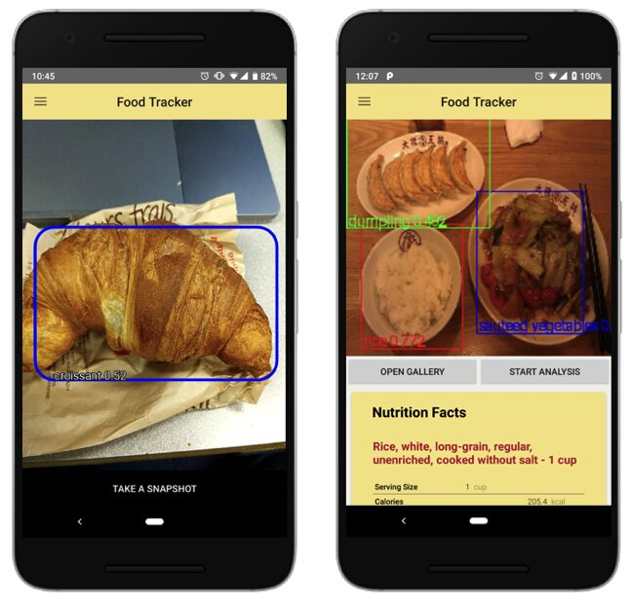
Limitations
Food recognition technology may struggle with accurately identifying complex dishes or homemade meals with multiple ingredients.
The accuracy of calorie estimation can vary depending on the quality of the image and the database used for analysis.
Individuals with unique dietary needs or cultural preferences may not always find accurate nutritional information for their specific meals.
Notes:
Image source: https://techxplore.com/news/2019-09-foodtracker-ai-powered-food-mobile-application.html

Slide 10

User Experience
User-friendly interfaces and intuitive design are crucial for the successful adoption of food recognition and calories estimation tools.
Providing feedback and suggestions for healthier alternatives based on the recognized food items can enhance the user experience.
Continuous updates and improvements based on user feedback can help refine the accuracy and usability of these technologies.
Notes:
Image source: https://www.freepik.com/blog/overview-basics-user-interface-design-uid/

Slide 11
Conclusion
Food recognition and calories estimation technology offer a promising solution to help individuals make healthier food choices and monitor their calorie intake more effectively.
Ongoing research and development efforts are focused on improving the accuracy, usability, and accessibility of these tools.
Embracing these advancements in nutrition technology can empower individuals to take control of their dietary habits and lead healthier lifestyles.
Notes:
Image source: https://azati.ai/portfolio/ai-calorie-calculator-and-food-recognition/

Slide 12
References
Smith, J. (2021). The Role of Artificial Intelligence in Food Recognition. Journal of Nutrition Technology, 12(3), 45-58.
Lee, A., & Kim, S. (2020). Enhancing User Experience in Food Recognition Apps. International Conference on Health Informatics, 103-115.
Johnson, R. et al. (2019). Ethical Considerations in Food Recognition Technology. Journal of Applied Ethics, 8(2), 212-225.

